Slide 1
SU2 8주차 보고서
2019011579 김세형

Slide 2
Cyl

Slide 3
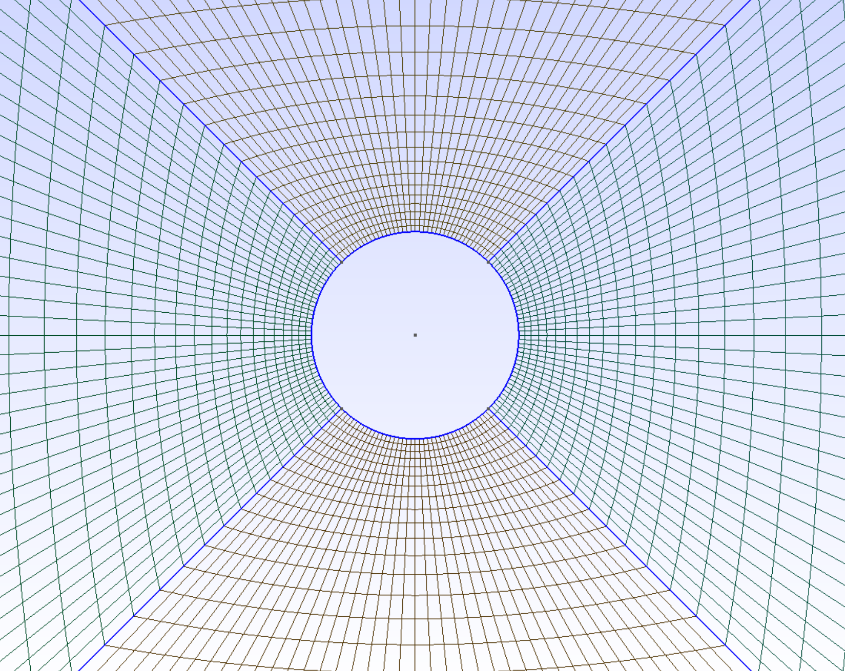
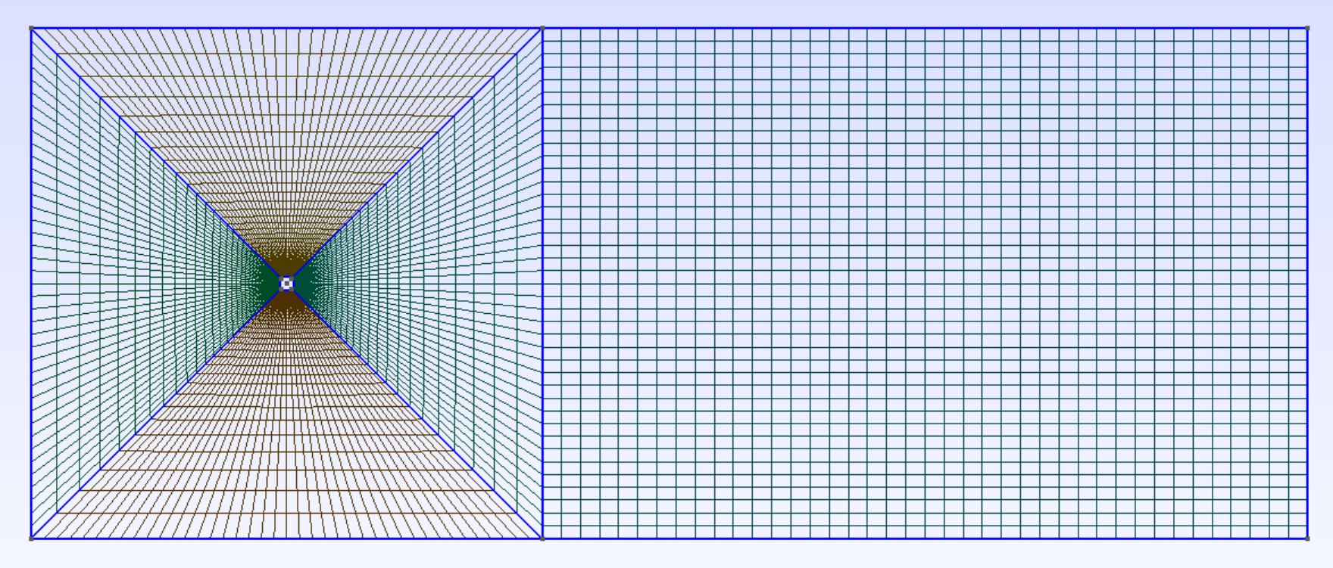
Simulation Condition & Mesh
Simulation Condition
Mesh
UNSTEADY SIMULATION
TIME_STEP= 0.01
MAX_TIME=25. 00
BOUNDARY CONDITION DEFINITION
MARKER_HEATFLUX= ( wall, 0.0 )
MARKER_FAR= ( inlet, outlet, top, bottom )
MARKER_MONITORING= ( wall )
INPUT/OUTPUT INFORMATION
OUTPUT_FILES= (RESTART, PARAVIEW)
OUTPUT_WRT_FREQ= (1000, 10)

Slide 4
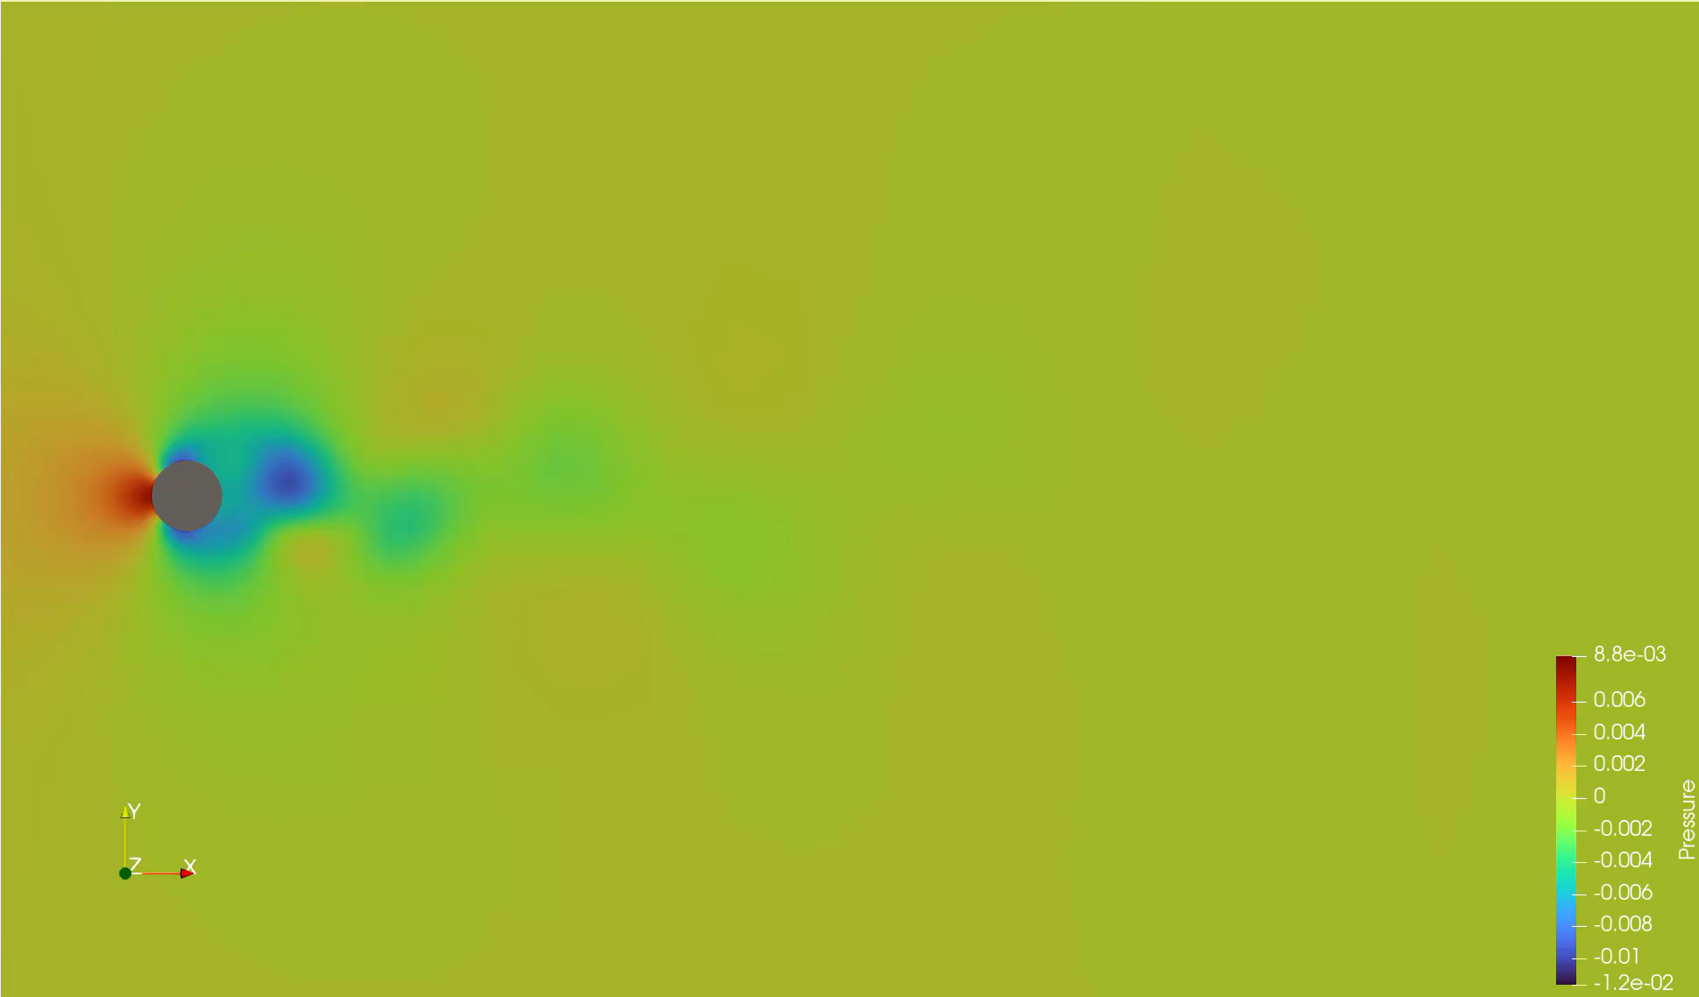
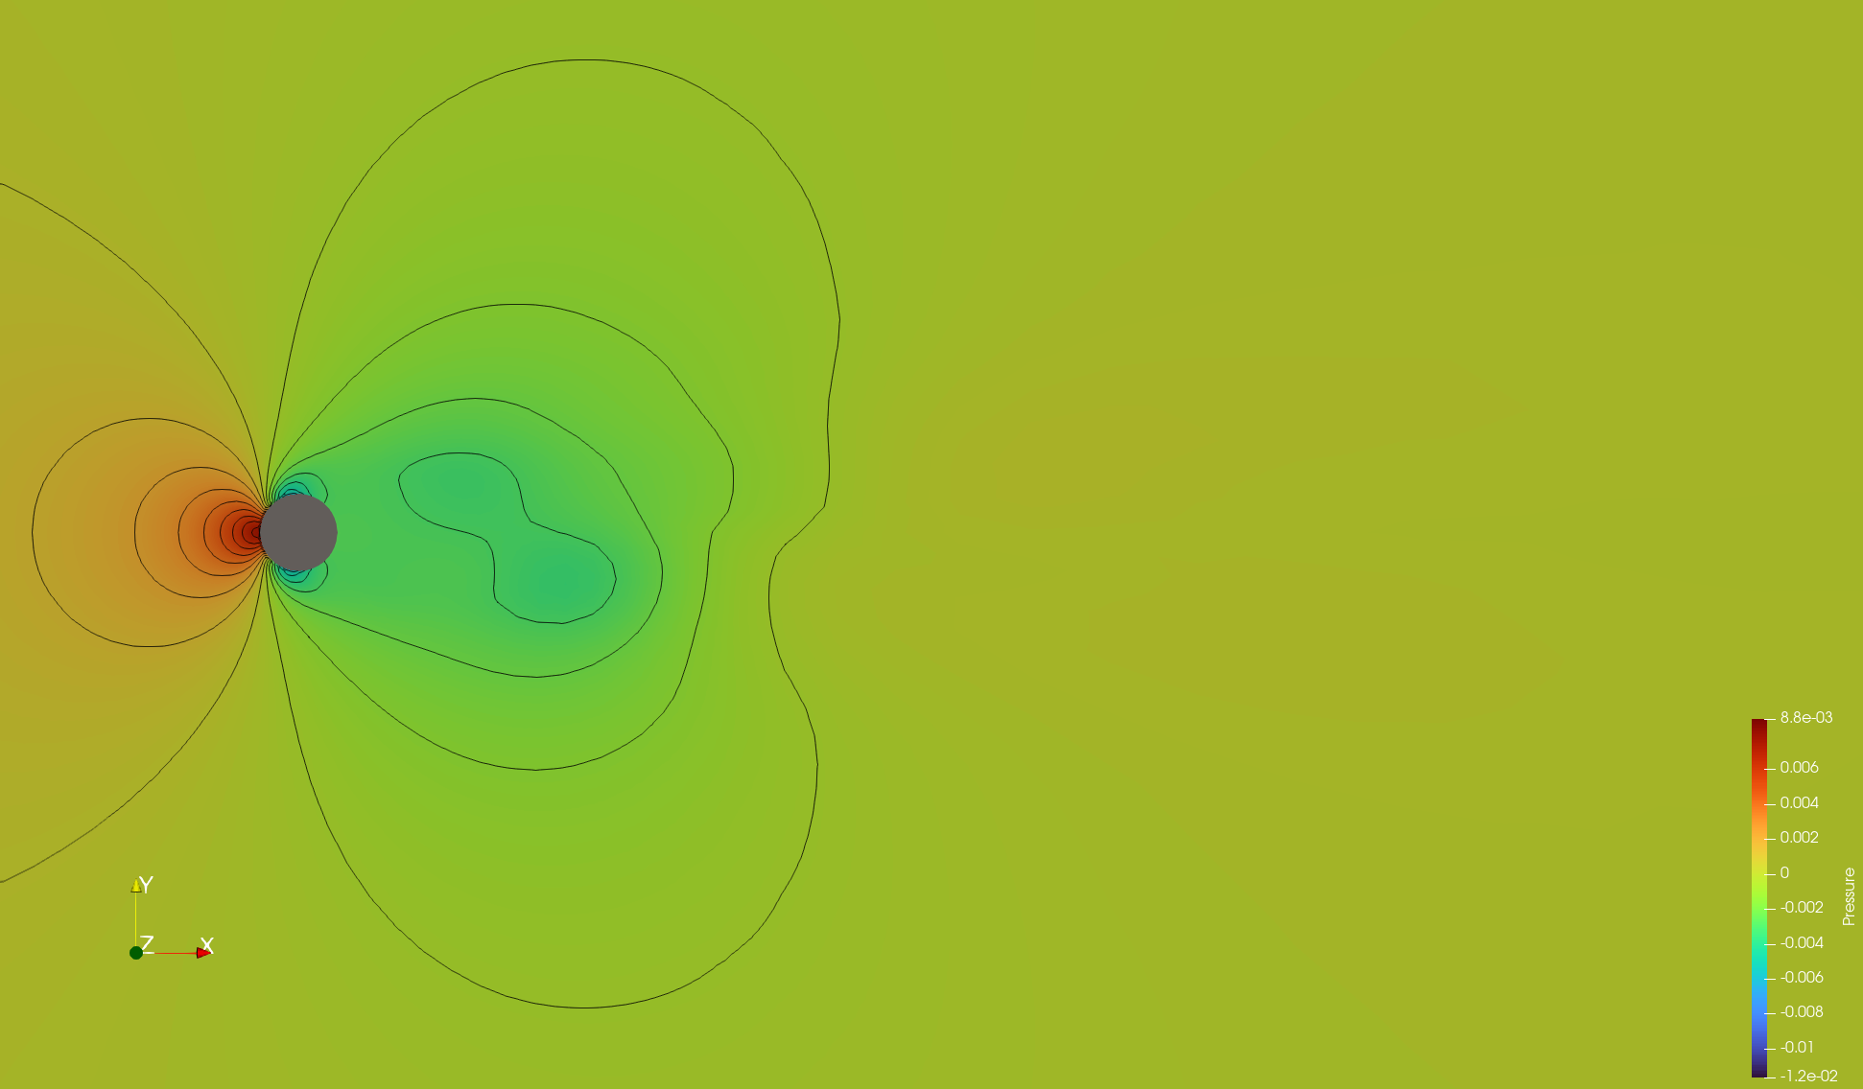
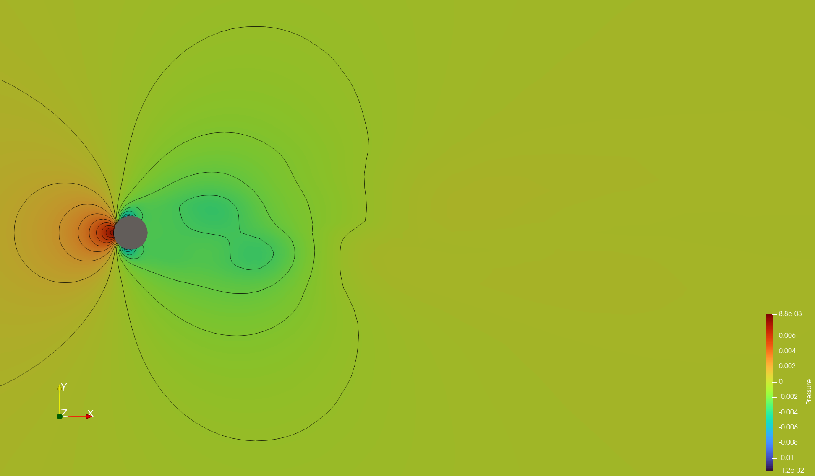
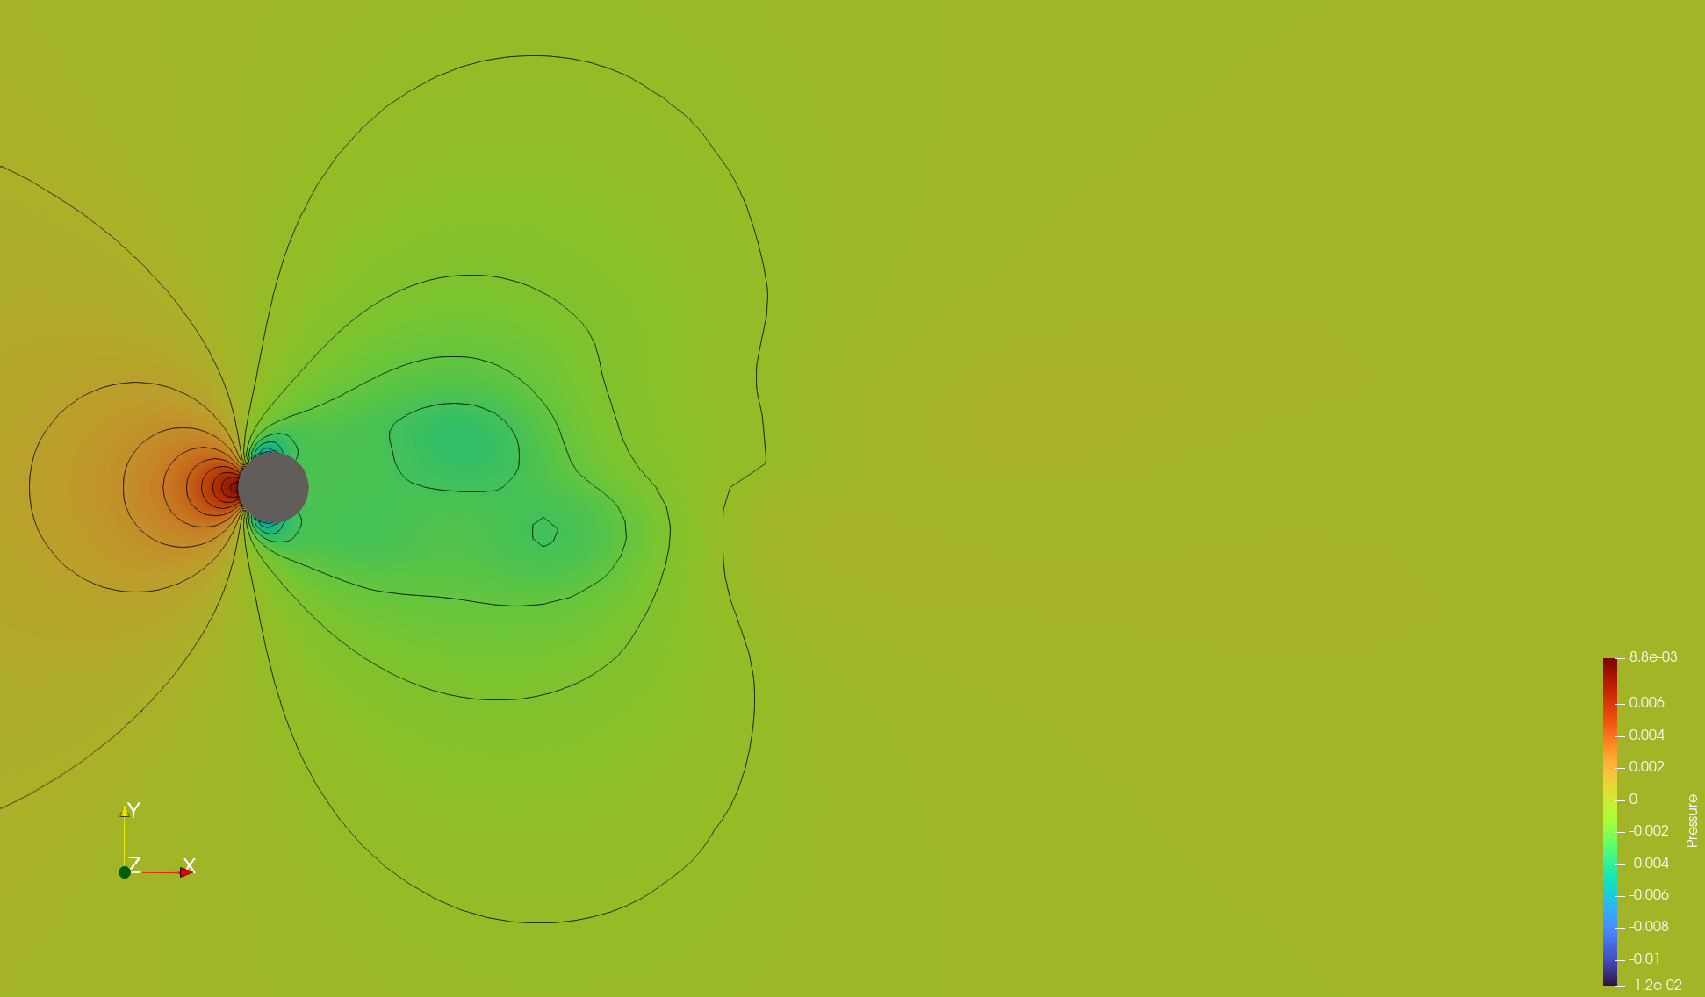
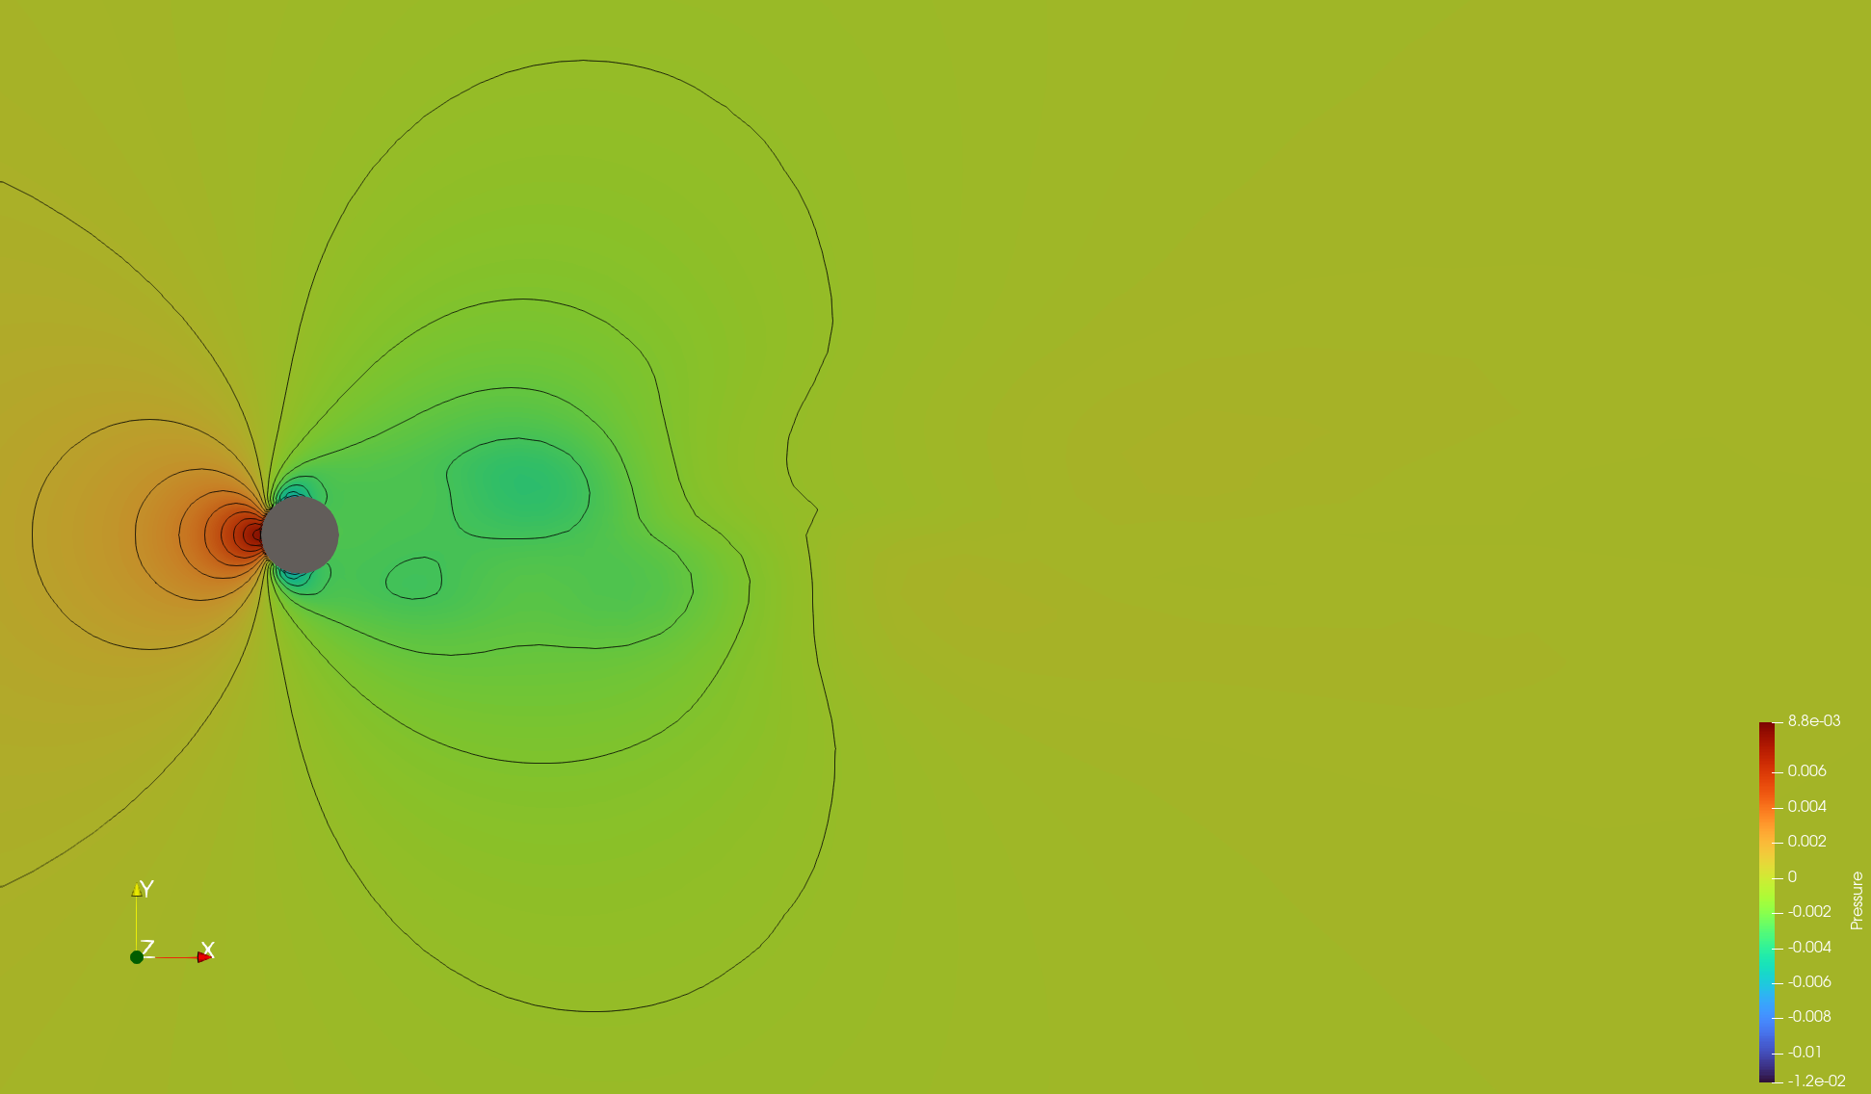
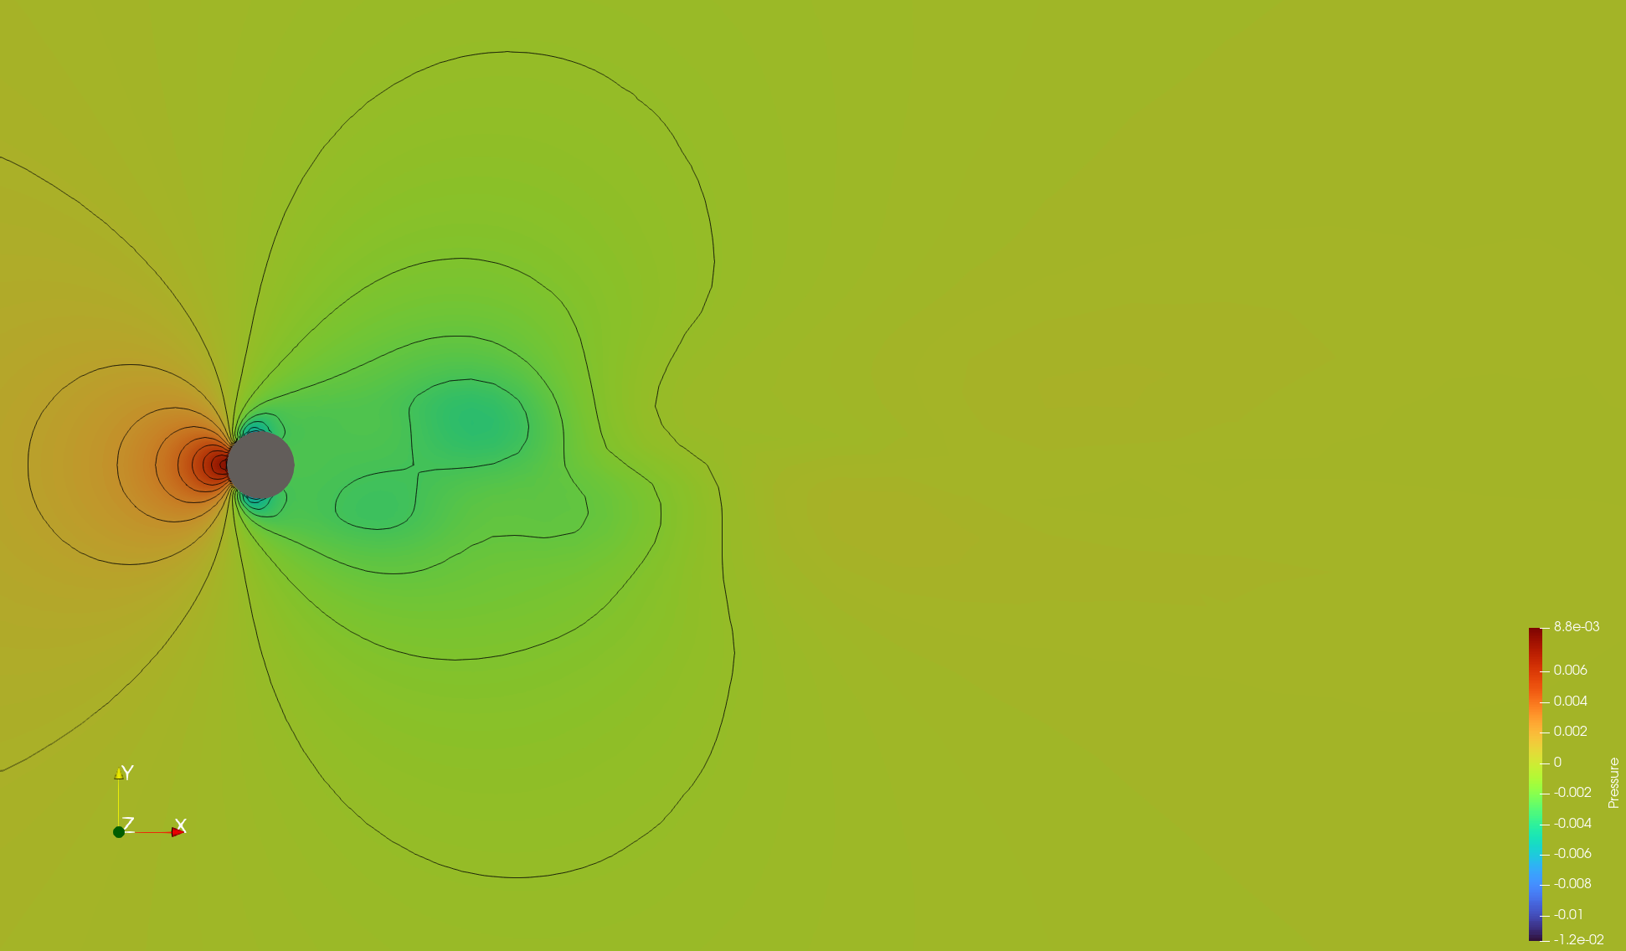
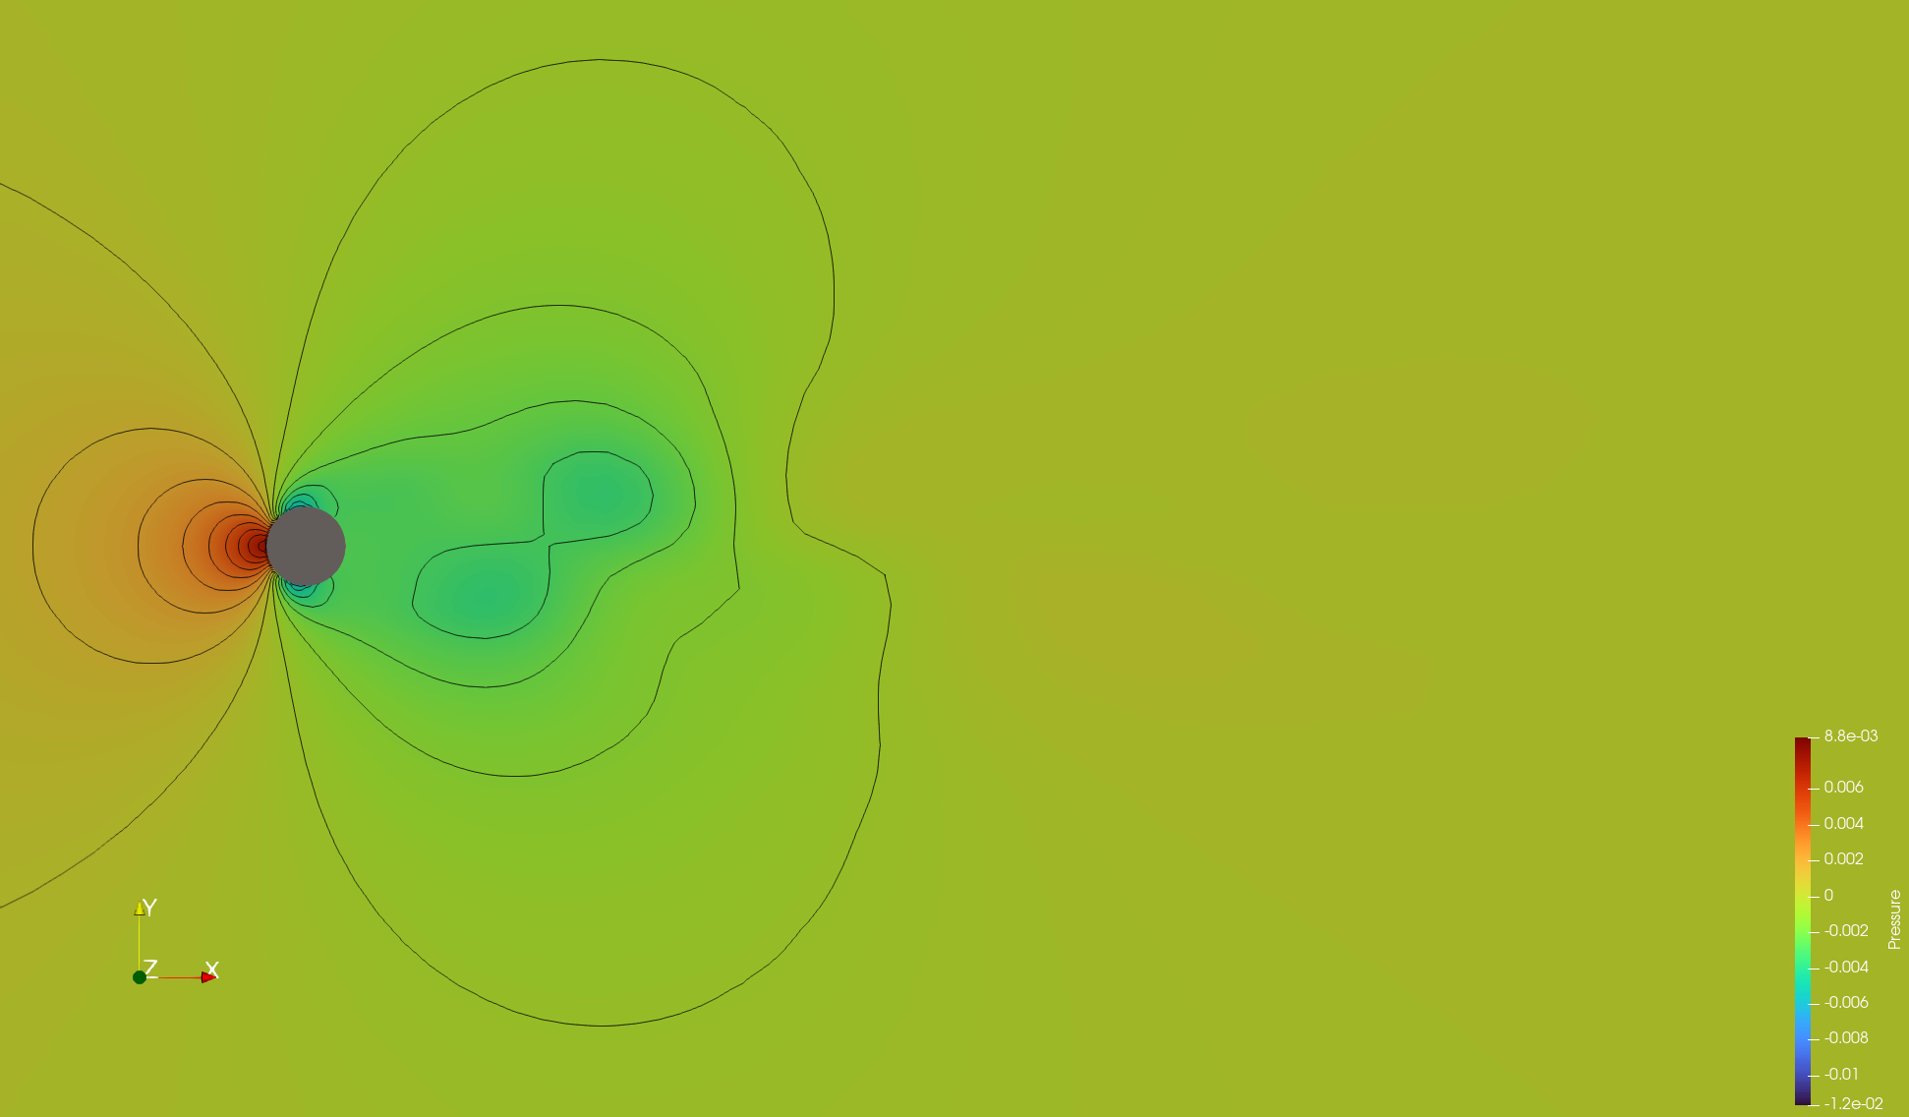
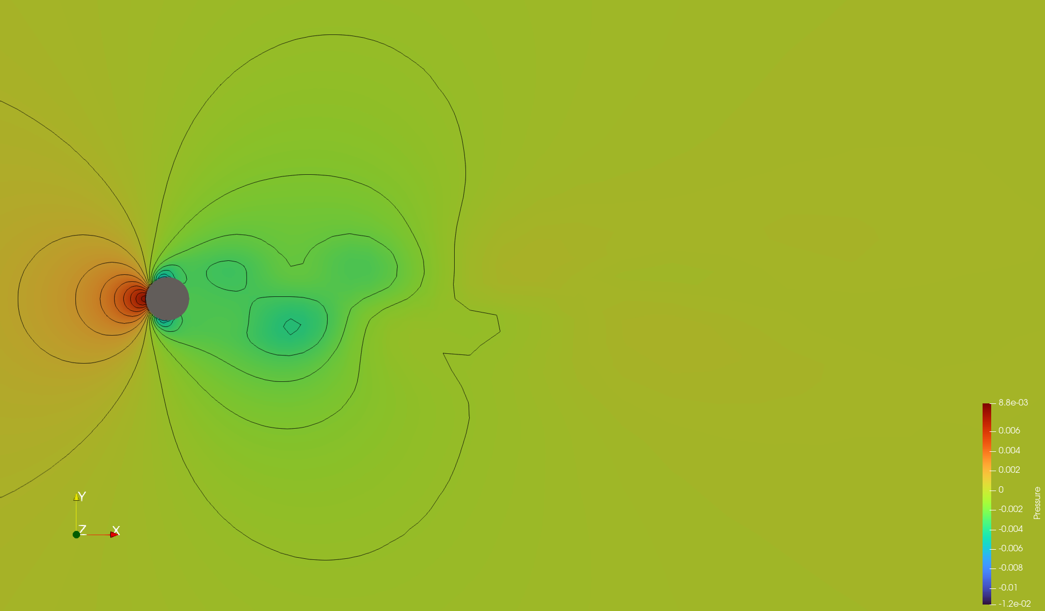
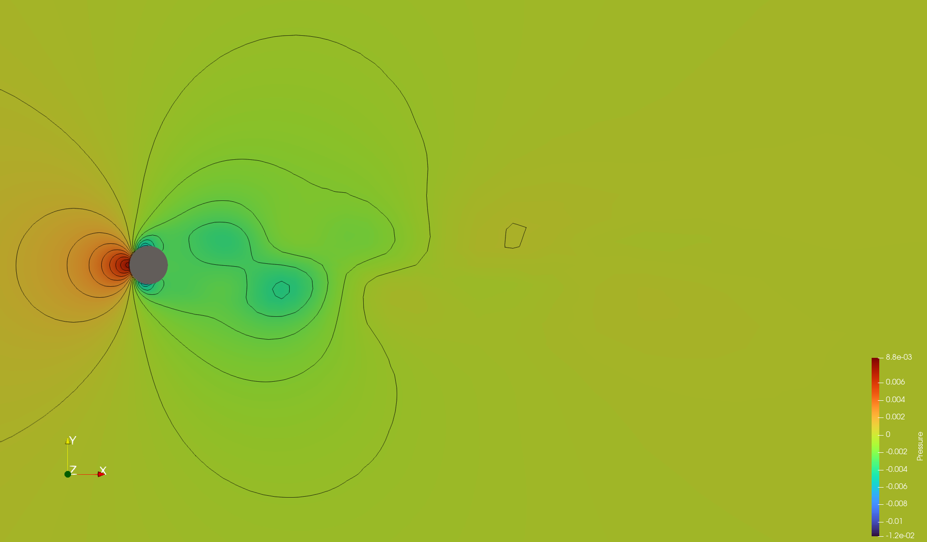
Pressure Contour

Slide 5
Analisys

Slide 6
Cylinder Wake

Slide 7
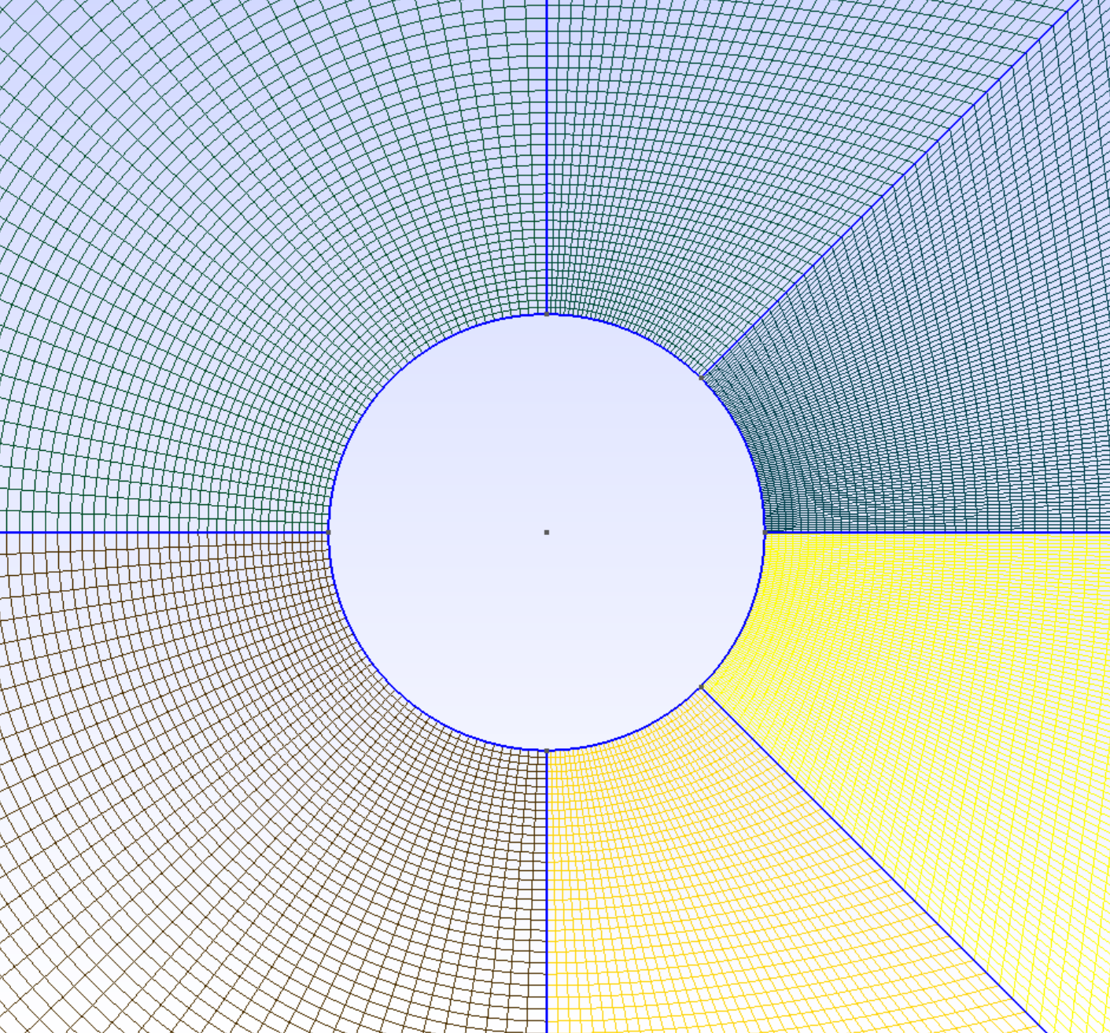
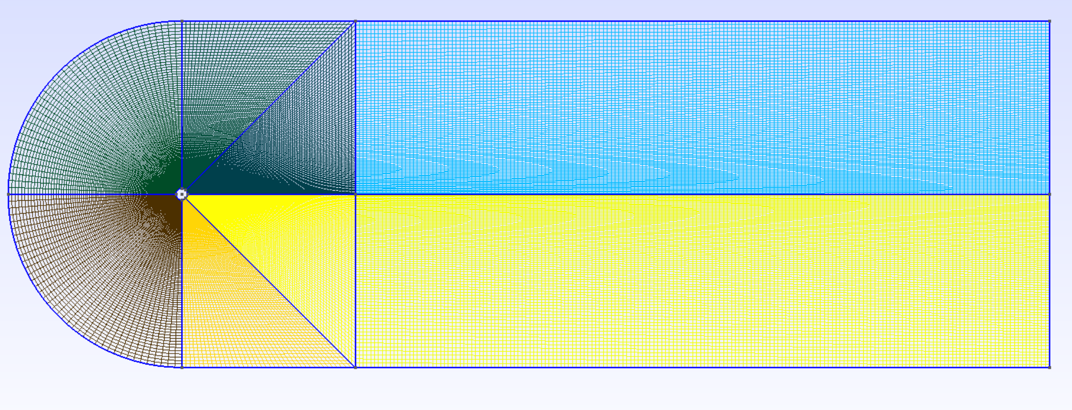
Simulation Condition & Mesh
Simulation Condition
Mesh
UNSTEADY SIMULATION
TIME_STEP= 0.01
MAX_TIME=25. 00
BOUNDARY CONDITION DEFINITION
MARKER_HEATFLUX= ( cylinder, 0.0 )
MARKER_FAR= ( farfield_in,farfield_side,farfield_out )
MARKER_MONITORING= ( cylinder )
INPUT/OUTPUT INFORMATION
OUTPUT_FILES= (RESTART, PARAVIEW)
OUTPUT_WRT_FREQ= (1000, 10)

Slide 8
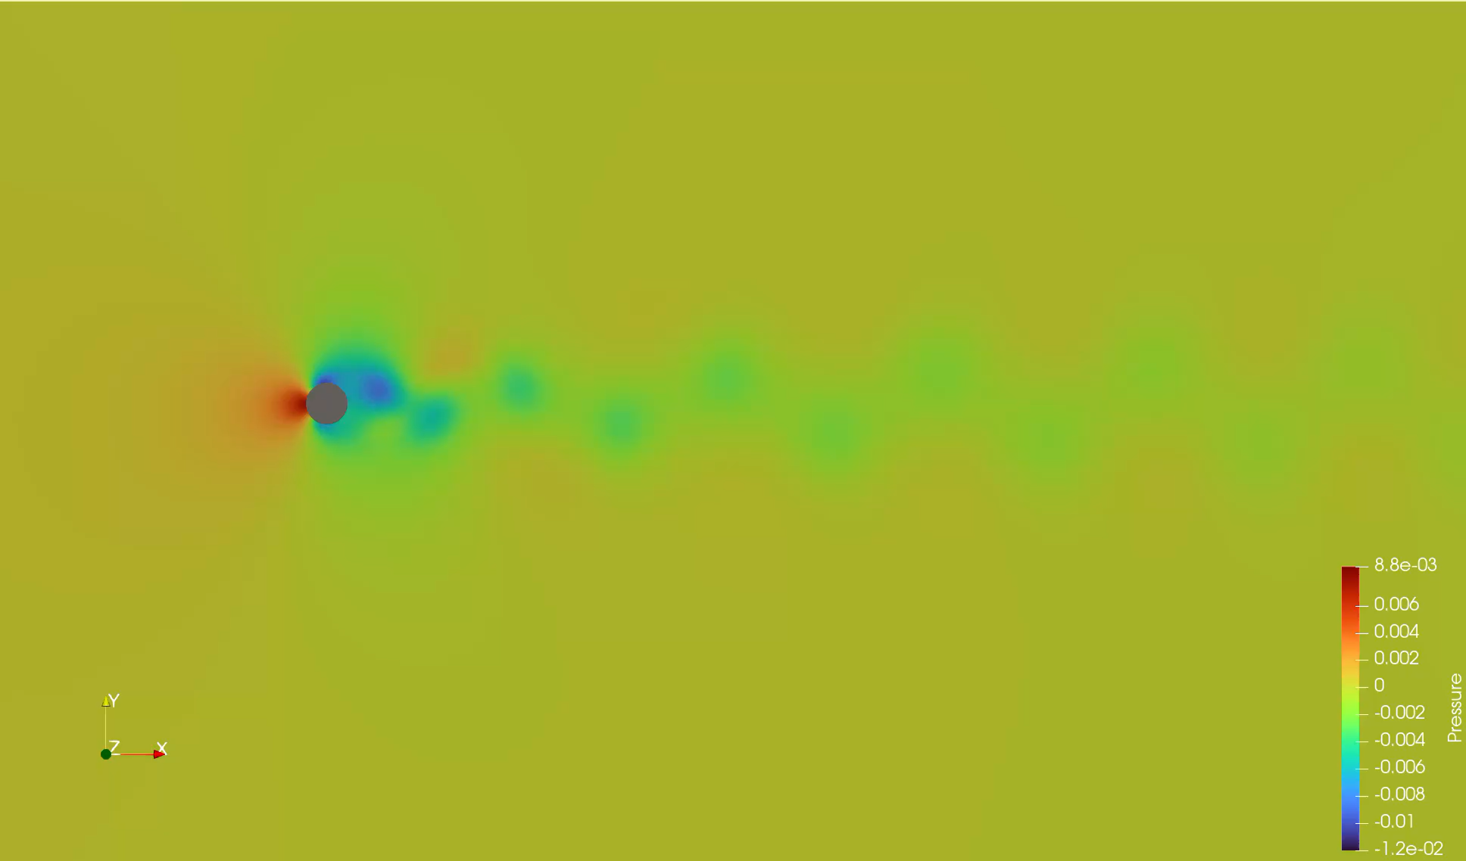
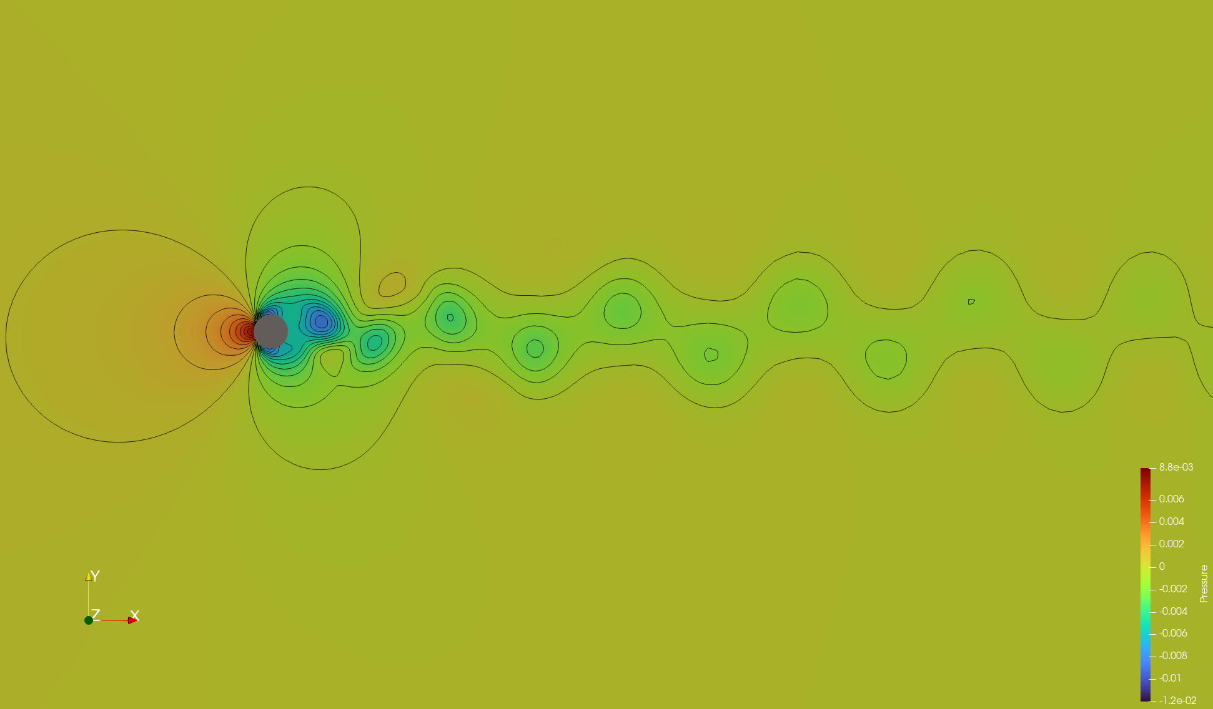
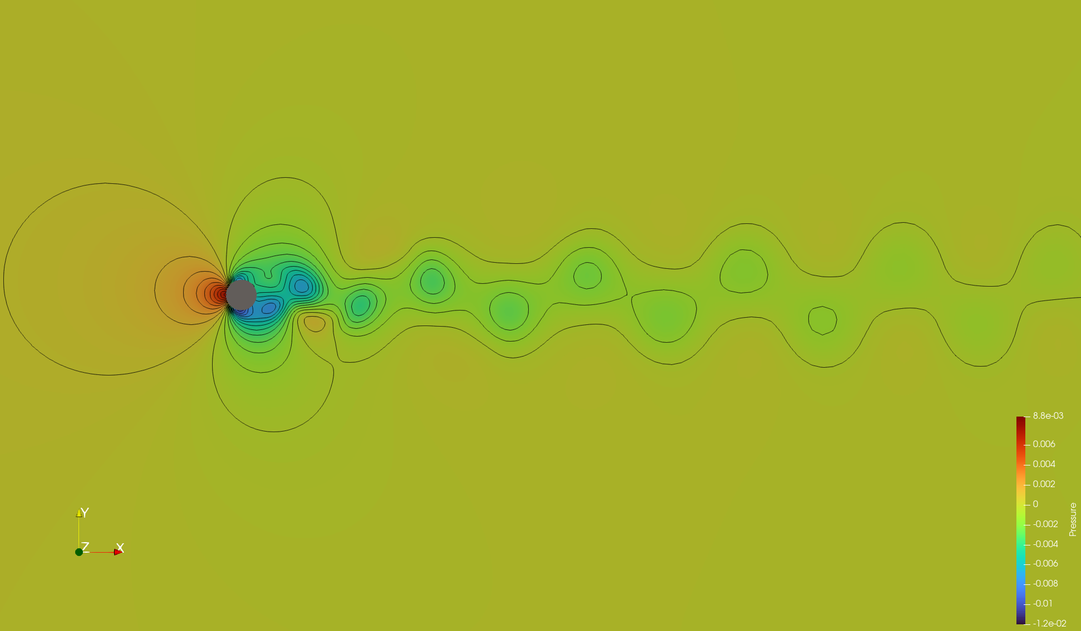
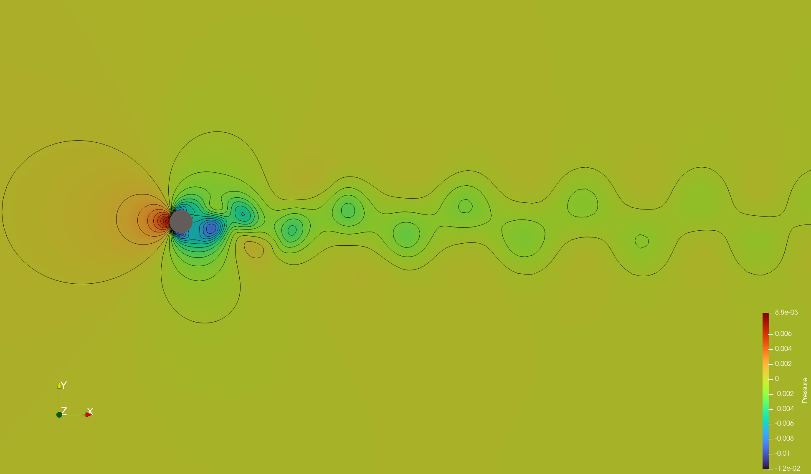
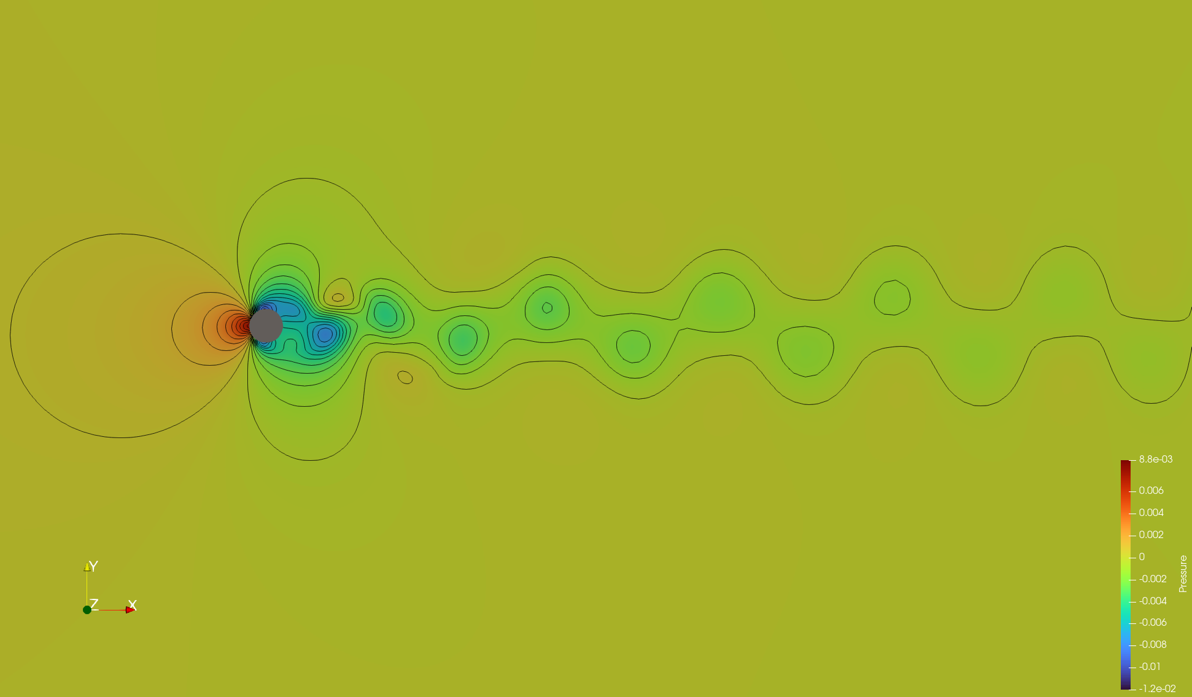
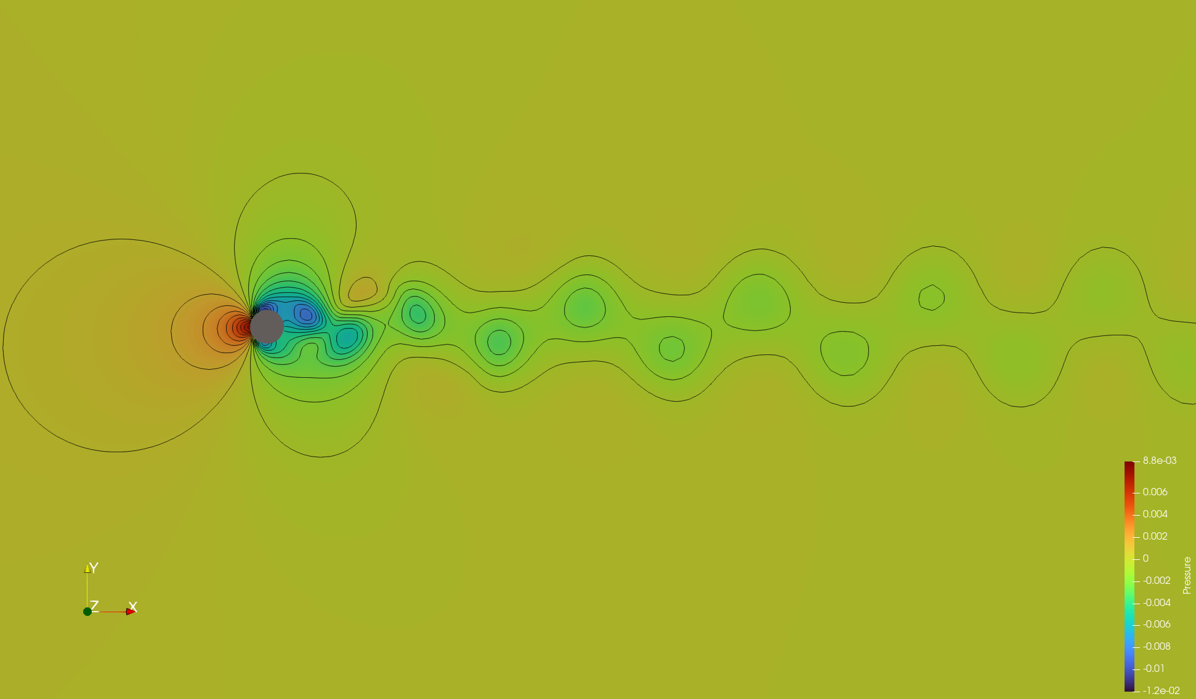



Pressure Contour

Slide 9
Analisys

Slide 10
Unsteady Pitch
RAE2822

Slide 11
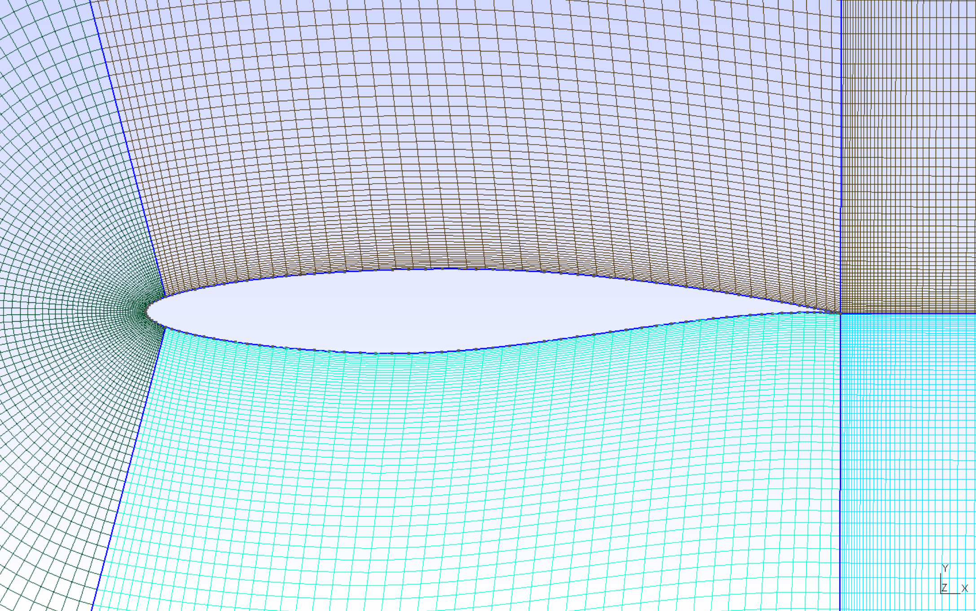
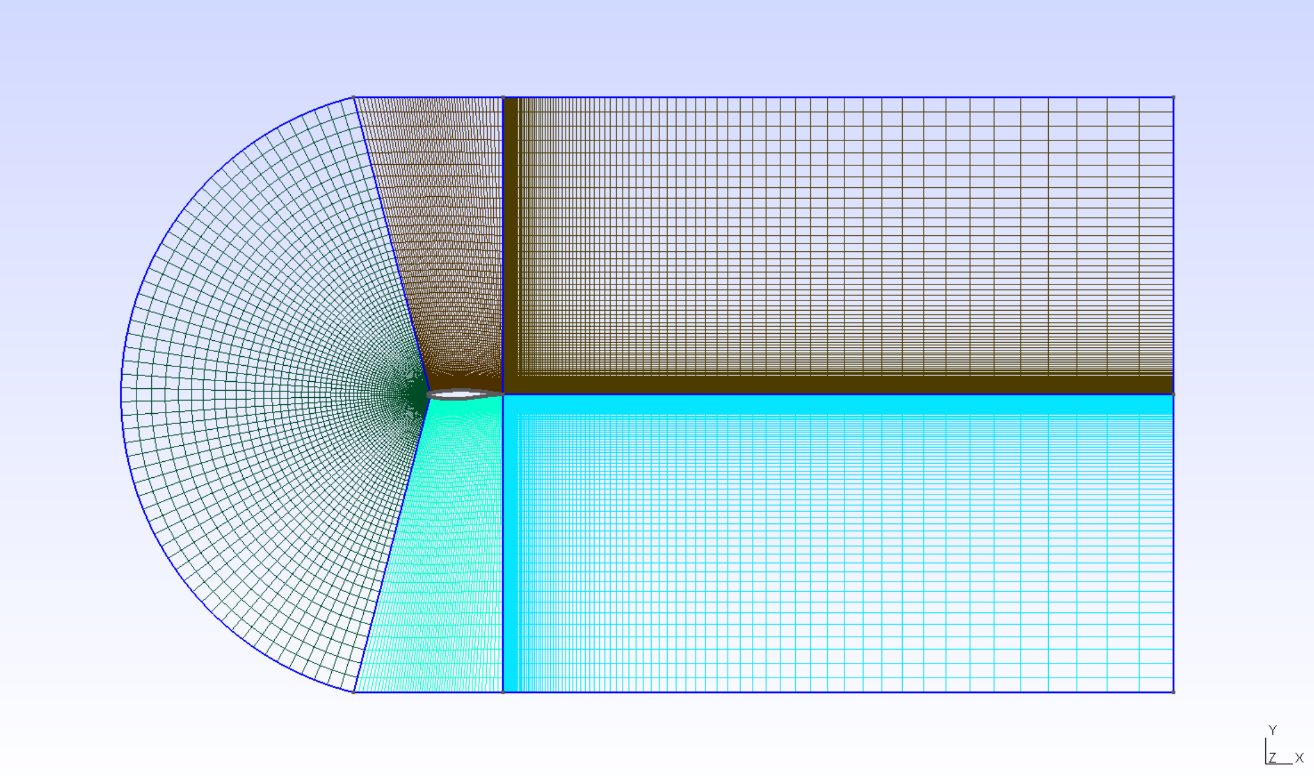
Simulation Condition & Mesh
Simulation Condition
Mesh
COMPRESSIBLE FREE-STREAM
MACH_NUMBER= 0.3
AOA= 17.0
BOUNDARY CONDITIONS
MARKER_HEATFLUX= ( airfoil, 0.0 )
MARKER_FAR= ( farfield )
MARKER_PLOTTING= ( airfoil )
MARKER_MONITORING= ( airfoil )
PITCHING MOTION PARAMETERS
GRID_MOVEMENT= RIGID_MOTION
MOTION_ORIGIN=(0.25,0.0,0.0)
PITCHING_AMPL=(0.0,0.0,8.0)
PITCHING_OMEGA=(0.0,0.0,14.91675)
TIME CONVERGENCE
TIME_ITER= 2000
INPUT/OUTPUT
OUTPUT_FILES= ( RESTART, PARAVIEW )
OUTPUT_WRT_FREQ= ( 1, 1 )

Slide 12
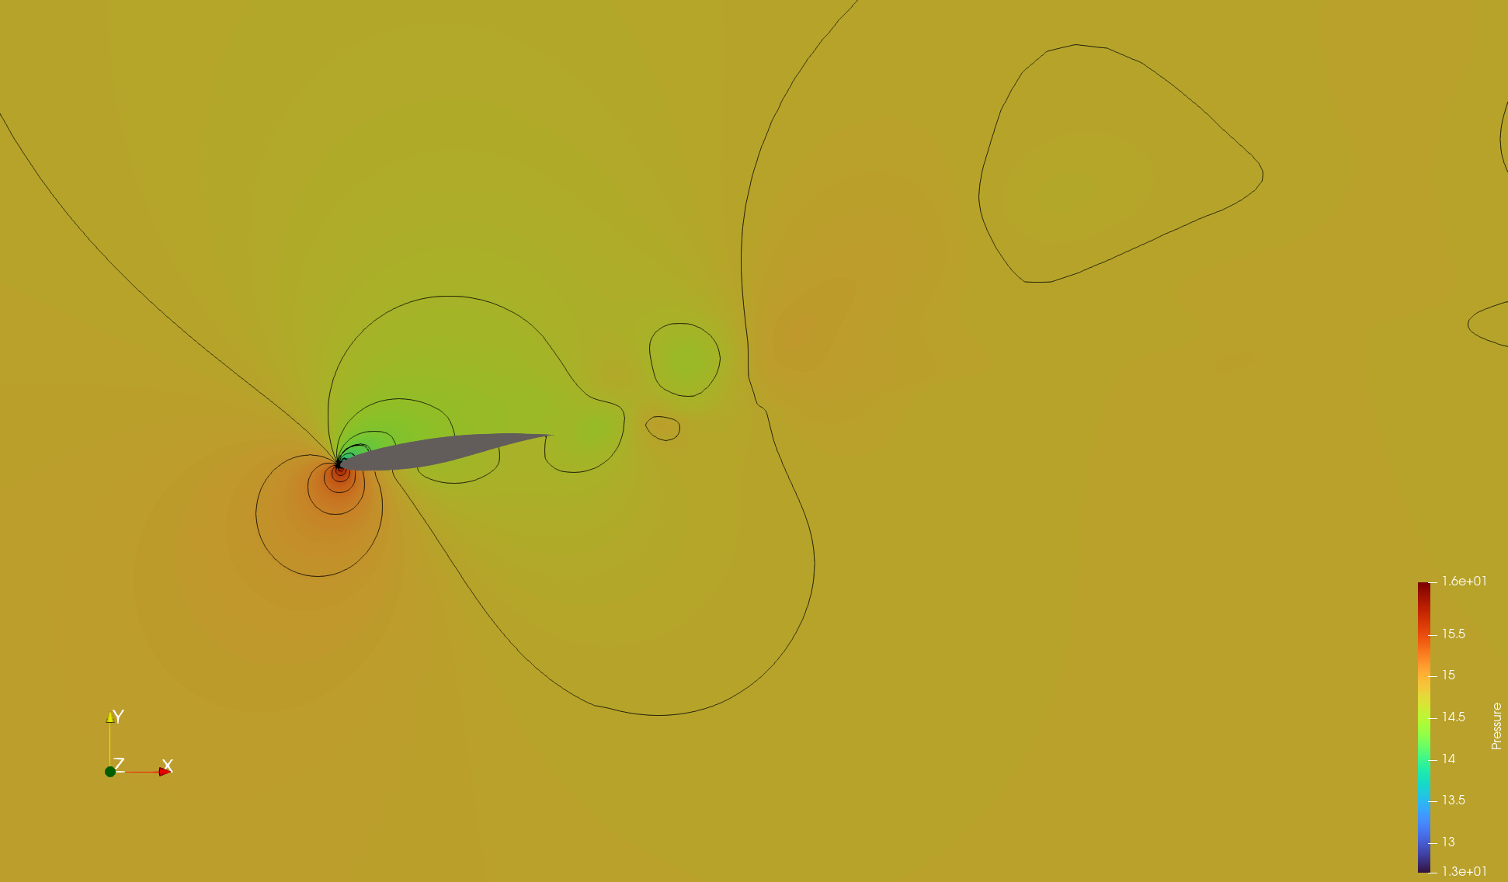
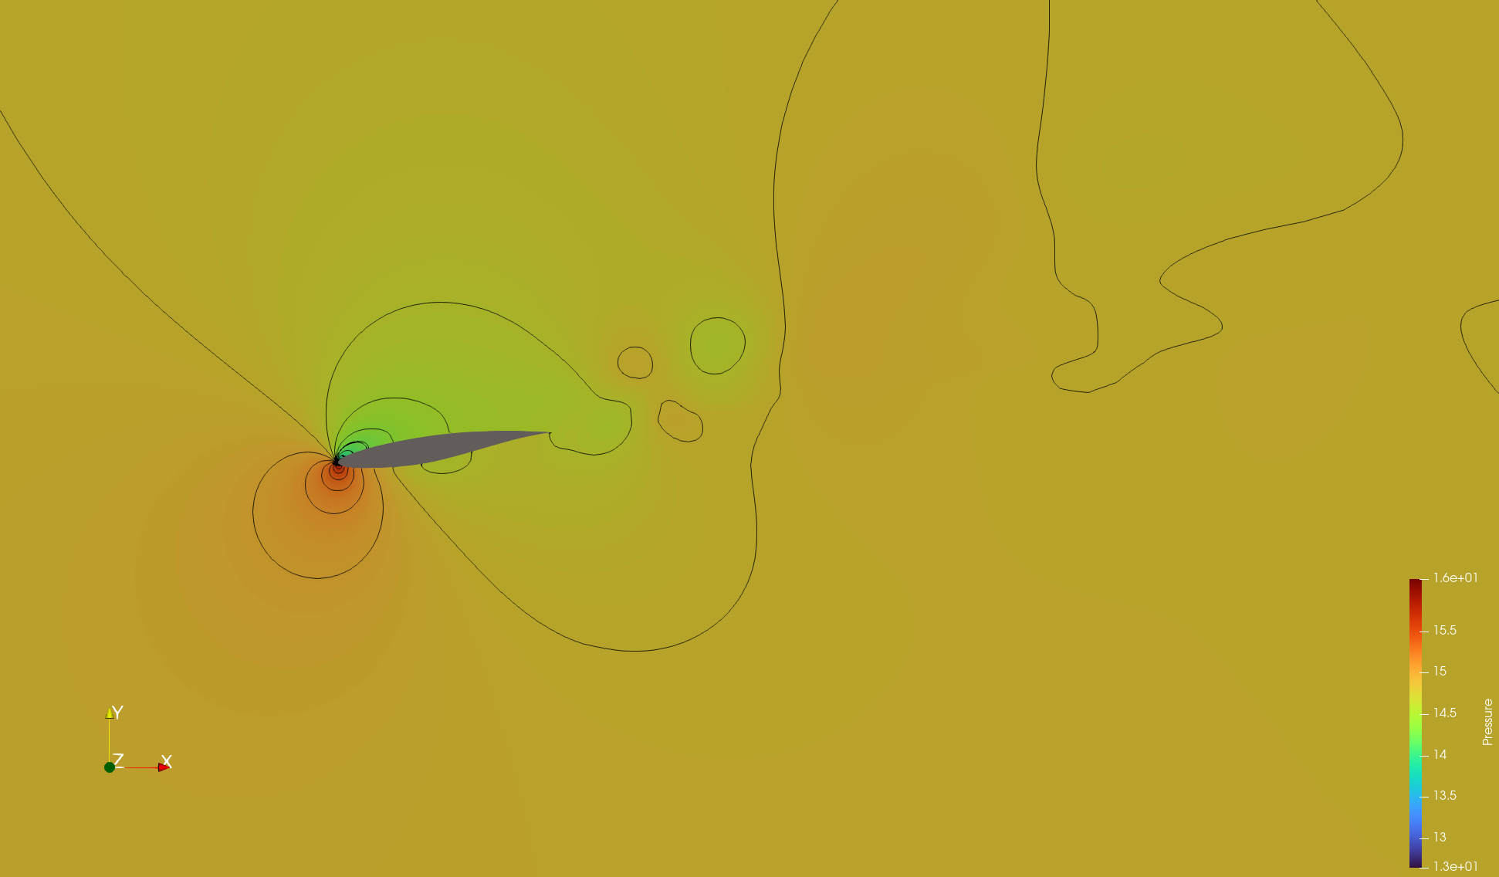
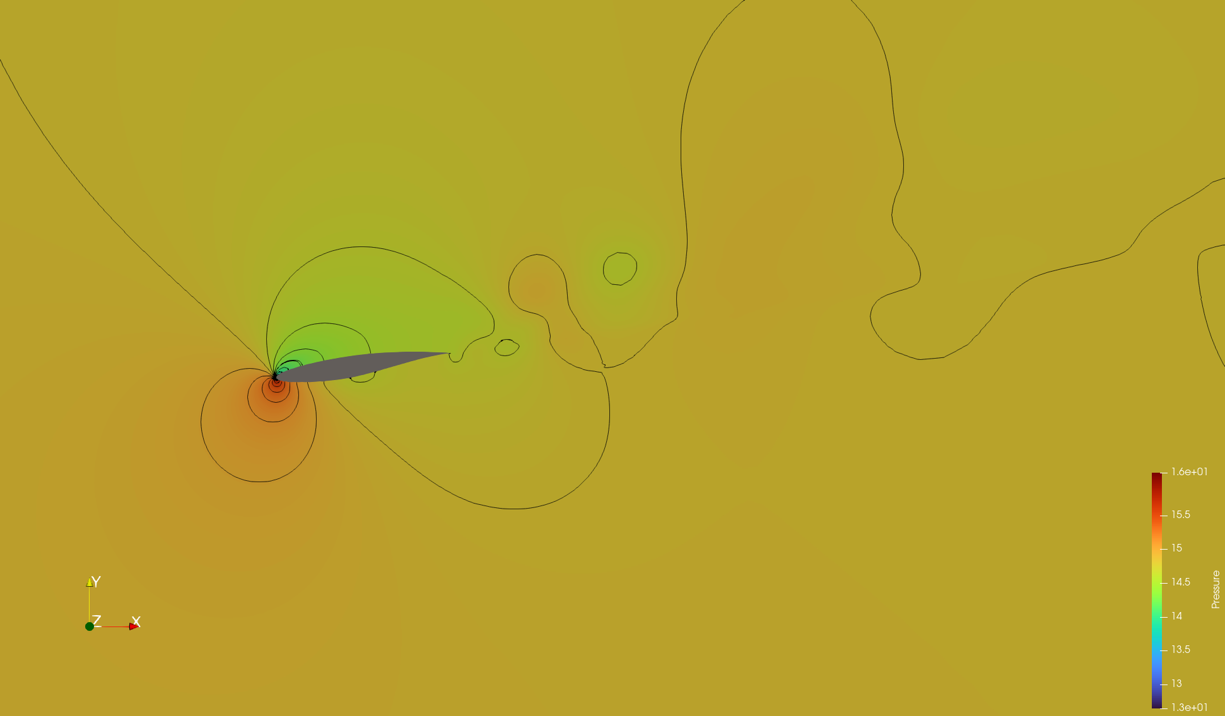
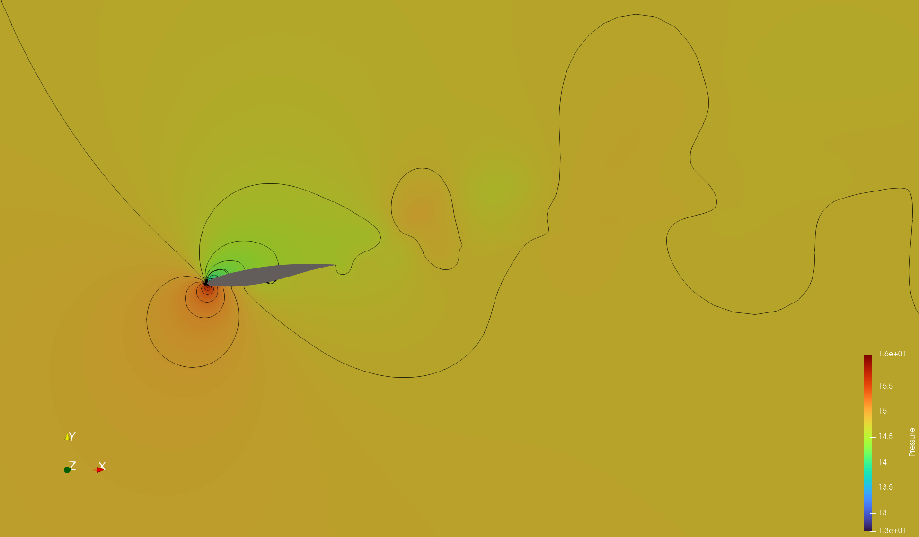
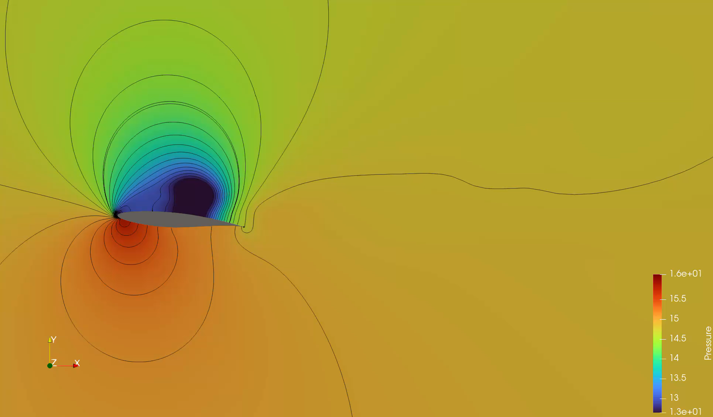

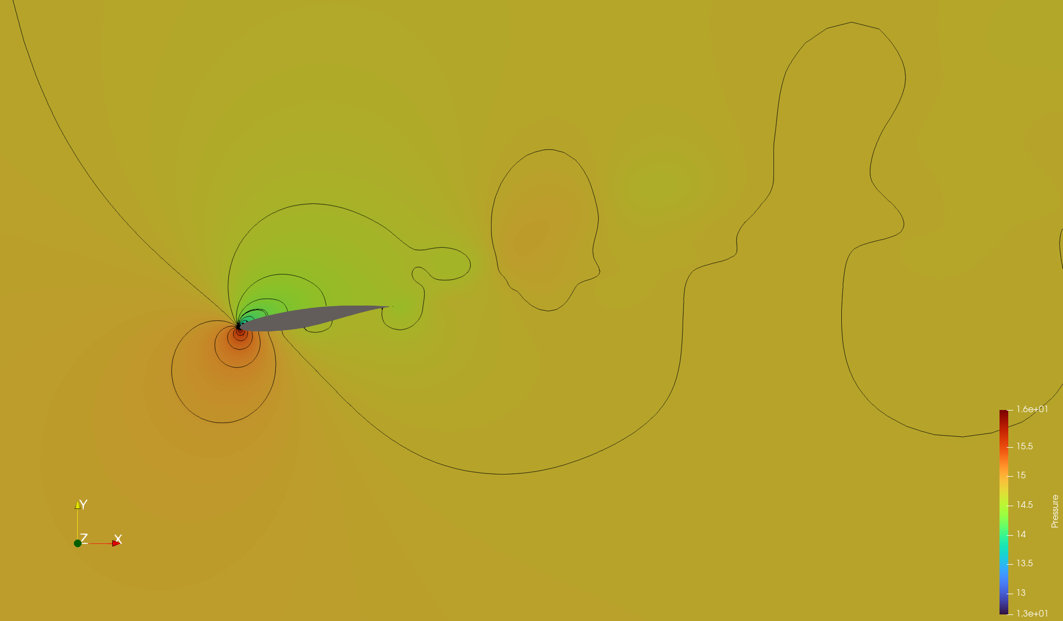
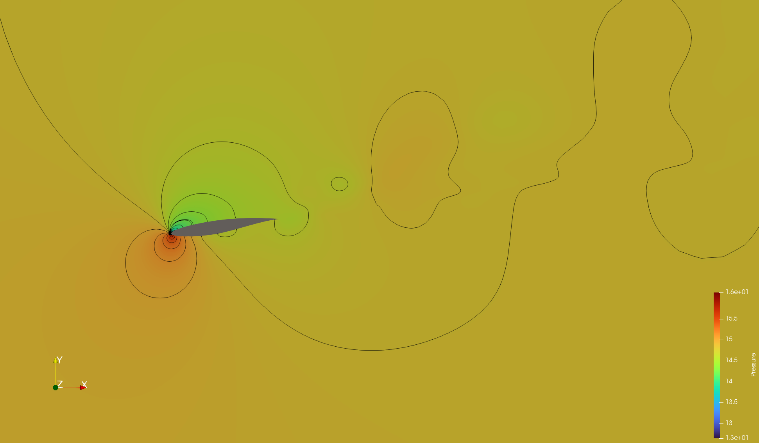

Pressure Contour

Slide 13
Analisys

Slide 14
Unsteady Pitch

Slide 15
Boundary Condition & Mesh
Boundary Condition
Mesh

Slide 16
Pressure Contour

Slide 17
Analisys

